Slide 1

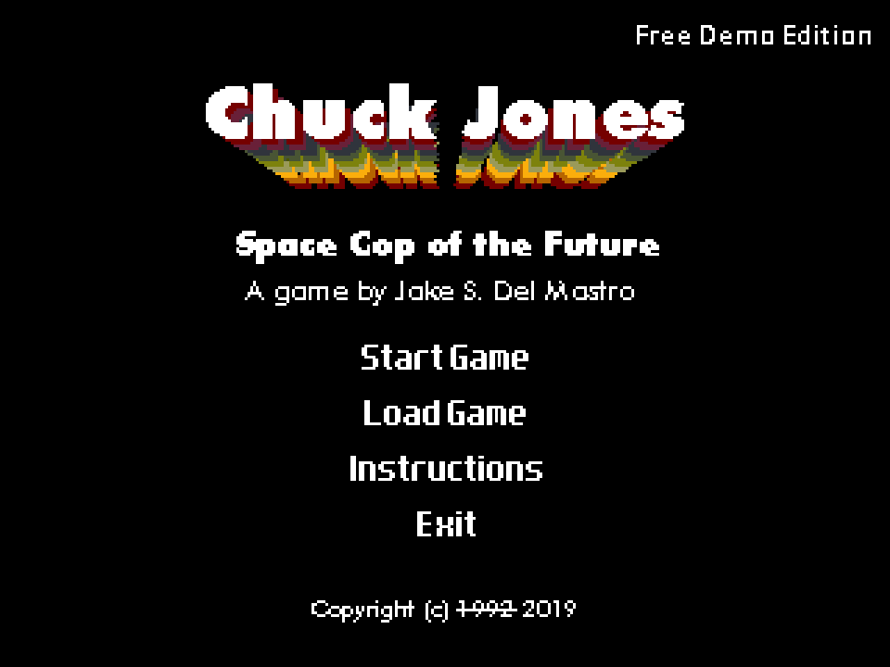
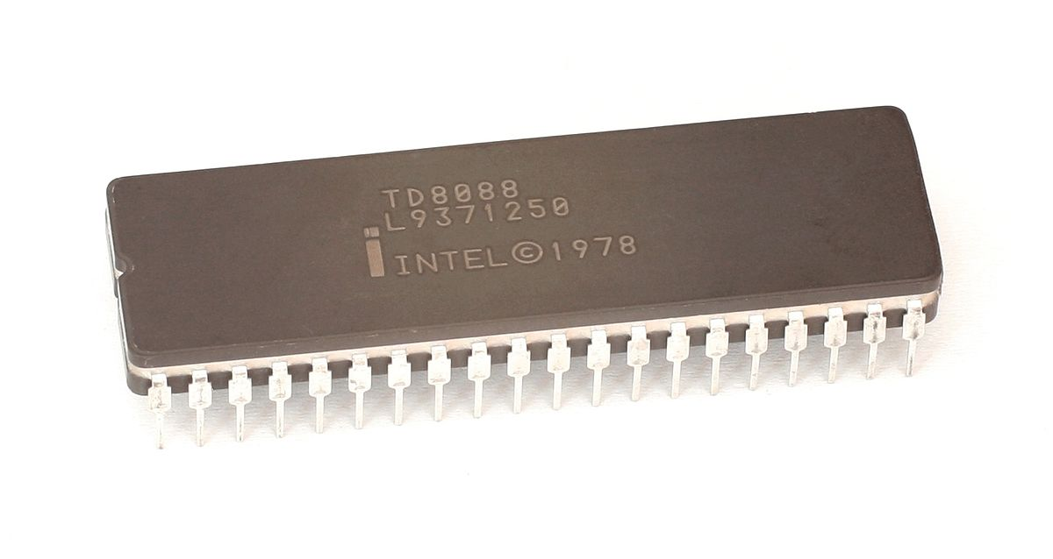
16-bit C++
Considerations for new code on ancient hardware
Jake S. Del Mastro
Notes:
- Hi, my name is Jake Del Mastro. I’m a software engineer at Autodesk, but tonight I’m going to talk a bit about a personal project that I’m doing for fun.
- I decided a while ago to try writing a point and click adventure game called “Chuck Jones: Space Cop of the Future” for MS-DOS. And in terms of cpu were are talking about a 16 bit intel 8088. Naturally I decided to do it in the best language: C++.

Slide 2
WARNING: PLEASE DO NOT USE THIS AS GENERAL C++ ADVICE
What do we want? | But how do we do that?
Good performance (speed) Not to run out of memory Well defined behaviour | Keep code small (48k) Avoid accessing memory Use your instruction set Read the output Simple solutions are usually the best
Notes:
Before I really get into it I just want to give a warning that you should not mistake any part of this talk for general C++ advice, I’m not using C++11 and writing code for a 40 year old processor is a highly specific use case. But anyways lets talk about this case.
Firstly when we’re any writing code we wanna look at what our goals are, ours are pretty simple ( read goals )
So how exactly do we accomplish this? Well ( read how )
So lets move on to some examples

Slide 3
Make sure you know what you're doing
//int == 16 bits
const int screenHeight = 200;
const int screenWidth = 320;
if (x < 0 || y < 0) return;
int pixelIndex = y * screenWidth + x;
//better, no overflow
const int16_t screenHeight = 200;
const int16_t screenWidth = 320;
if (x < 0 || y < 0) return;
uint16_t pixelIndex = (uint16_t)y * screenWidth + x;
Notes:
So on the intel 8088 an int is 16 bits. There are also a couple of other types that are sizes you might not expect.
I’m gonna show you a contrived example because I don’t have enough time to explain planar graphics
Does anyone see whats wrong here
Ok so what I do is use stdint types for everything because it helps me see what is actually going on.

Slide 4
Design the code around the machine
//fill function table for OPL driver
static void(near* const near opl_funcs[8]) (uint8_t, uint8_t, uint8_t) = { OPL_note_off, OPL_note_on, nothing, OPL_handle_cc, OPL_program_change, nothing, nothing, nothing };
_FAR_SS void handle_midi_Message() {
do {
//Read message & stuff...
const uint8_t arg0 = *(midiBuf++);
const uint8_t arg1 = *midiBuf;
//execute the action from the function table
midi_funcs[message & 0x07](status, arg0, arg1);
//Do a bit more stuff...
midi_message_timer = read_var_len(midiBuf); //set timer for next event
} while (midi_message_timer == 0);
midi_sound::current_trackPtr = midiBuf; //update the index
}
Notes:
So to play the music in the game I use midi, and there are several different audio devices that I can use to play it back
So at run time we load a table of function pointers to handle different midi messages
Luckily on the 8088 there is an instruction that basically dereferences a function pointer at an address and then calls it in one go
I verified this by looking at the assembly and this ends up being a really efficient way to process midi messages

Slide 5
Break the type system when it helps
//just two lists of pointers, but the template will be instantiated twice
std::vector<gameObject*> gameObject::object_table;
std::vector<scriptProcess*> scriptProcess::script_table;
//only instantiated once
std::vector<void*> gameObject::object_table;
std::vector<void*> scriptProcess::script_table;
inline scriptProcess& getProcess(scriptProcess::processID s) {
return *static_cast<scriptProcess*>(scriptProcess::script_table[s]);
}
inline gameObject& getObjectByID(gameObject::idType o) {
return *static_cast<gameObject*>(gameObject::object_table[o]);
}
Notes:
So we wanna reduce code size right.
The problem here is that despite these two templates generating exactly the same code, the compiler does it twice
So lets just do a stupid kludge and use a void pointer.
And lets just hide this away in some wrapper functions, hey its simple but it saves me like 5k of memory

Slide 6
Fancy CPU Instructions
rep movsb is probably the greatest CPU instruction ever invented
How can we use it?
memcpy() and friends
//this needs to be fast because it needs to finish before the retrace finishes
void colorPalette::updateRange(uint8_t startIndex, const uint8_t* values, uint16_t length)
{
uint8_t* pPtr = paletteBuffer + startIndex * 3;
memcpy(pPtr, values, length); //memcpy to the rescue
numModified = int_max((int16_t)startIndex * 3 + length, numModified);
}
Notes:
Rep movsb is a fast copy instruction it moves one byte from one address to another increments both addresses and then repeats a specified number of times WITHOUT branching
The compiler implements memcpy as an inline function using optimized assembly

Slide 7
C++ isn't always the answer
I was super sad when I realized this
Write pure assembly when necessary (e.g. graphics functions)
Be creative: I designed an entire language to compress the logic required for adventure games
//chuckscript
if selected_object == NONE
{
use_hands arg_1 this
}
else if selected_object == gas_can
{
car_fueled = true
remove_from_inventory arg_1 gas_can
selected_object = NONE
play_sound did_something_sound
}
Notes:
Ok so what do you do when you’ve done all you can and it still isn’t good enough
Well it really pains me to say but C++ isn’t always the answer
Most of the super high performance graphics routines are done using inline assembly
I designed an entire language in order to compress adventure game logic, I don’t really have time to discuss this so…

Slide 8

Plugs
Find me online:
Twitter: @jakedelmastro
Web: jakedelmastro.com
Demos: pgram.itch.io
GitHub: github.com/pgrAm
Special thanks to:
OpenWatcomV2 Project
Notes:
In conclusion writing this kinda code is really not that hard, it just demands that you keep it simple and pay attention
I hope you enjoyed my talk
If you want to know more or are interested in the game itself. You can find me on the internet or right here after the talk

